Slide 1
Adult Students and Special Learning Needs (SLNs)
1st Aid for Teachers: the 4 Ps
Toronto School District Board

Slide 2
I. Is this really a problem?
A. Statistics:
1. General population - 15% of the U.S. adult population (U..S. Office of Spec. Ed., 2016) 2. Adult Ed population - some estimates as high as 80% (Seattle-King County Private Industry Council, 2000) 3. ESL population - most likely not nearly this high B. Your experience in your classes?

Slide 3
II. Possible reasons for suspecting SLNs
- education level - poor study habits - L₁ interference (esp. if non-Roman alphabet) - stress or trauma

Slide 4
II. Possible reasons for suspecting SLNs, cont’d.
- age, physical health, diet - external problems (work, health, family)
- irregular attendance - little practice outside the classroom

Slide 5
III. Overview of Learning Challenges
Special Learning Needs
Auditory Processing Disorder
Dyslexia
Dysgraphia
Dyscalculia
Dyspraxia
Visual Perceptual/ Visual Motor Disorder
Language Processing Disorder
Learning Disabilities Association of America, 2018

Slide 6
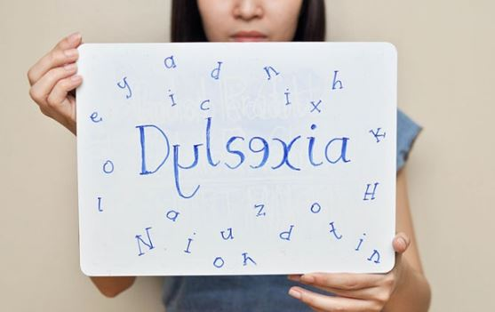
A. Dyslexia ▪ reading and language-based processing
LDA, 2018

Slide 7
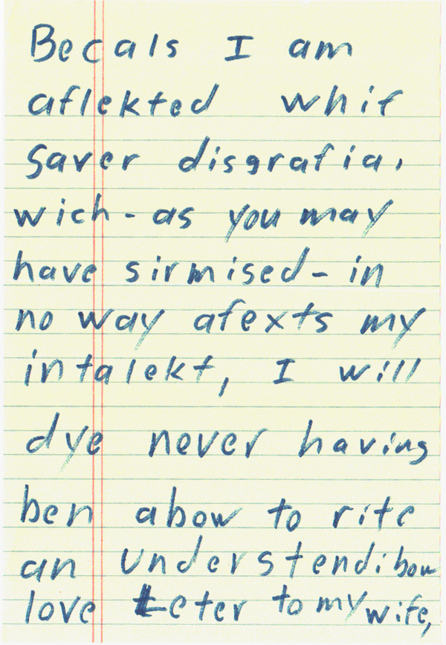
B. Dysgraphia ▪ handwriting ability and fine motor skills
LDA, 2018

Slide 8
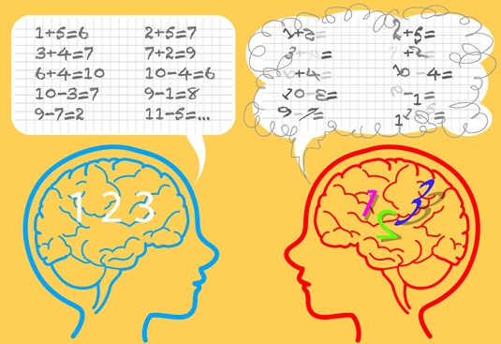
C. Dyscalculia ▪ numbers and math facts understanding
LDA, 2018

Slide 9
D. Dyspraxia (Non-verbal Learning Disability) ▪ interpretation of nonverbal cues, physical coordination
LDA, 2018

Slide 10
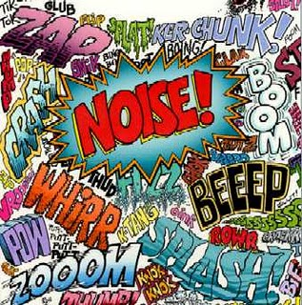
E. Auditory Processing Disorder
▪ sound processing and brain interpretation
LDA, 2018

Slide 11
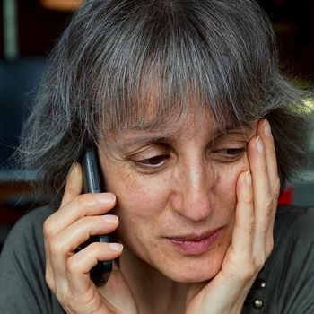
E.1. Language Processing Disorder ▪ specific APD - attaching meaning to sound groups
LDA, 2018

Slide 12
F. Visual Perceptual/Visual Motor Deficit: ▪ understanding of visual information, drawing or copying ability
LDA, 2018

Slide 13
IV. Possible Reasons for SLNs
Pre-natal factors
Environmental factors during infancy
Adulthood: dementia, traumatic brain injury, etc.
No early childhood intellectual dev. support
Brain-structure differences (heredity)
www.nichd.nih.gov/health/topics/learning/contioninfo/causes

Slide 14
Question: What can you do?
. . .

Slide 15
V. Administer 1st Aid for Teachers!
American Red Cross – the Four Bs:
Bleeding Breathing
Broken bones Burns
Adult Ed Teachers with Students with SLNs – the Four Ps: Print Pictures and Graphics Patience Physical Movement

Slide 16
→Print
A. Font Choice 1. Sans Serif (without curls or “tails”) 2. Single storey a, not double storey a a. Century Gothic b. Tw Cen MT (Twentieth Century Monotype) c. MV Boli d. Comic Sans

Slide 17
Print, cont’d.
3. Free fonts Lexia Readable Open-Dyslexic Dyslexie
4. Purchasable fonts Sylexiad

Slide 18
Print, cont’d.
B. Font Size 1. Larger than 12 pt, and no italics
C. Font and Background Color
1. Dark blue text on a pale cream or yellow background (TW Cen MT)
2. Gray background is also beneficial

Slide 19
Print, cont’d.
D. Lines and Spacing a.1.5 spacing between lines
b. Only 1 space after end punctuation (no white rivers)
c. Lines for student writing (after questions, for paragraphs, etc.) d. Reduce amount of text

Slide 20
Print Example:
1.
A. Scrambled Sentence Exercise Arrange the words and punctuation below in the correct order:
? how in many party your are ____________________________________________________________
2. ? like a table or a booth would you _____________________________________________________________

Slide 21
Print Example:
2.
Min’s parents and his three brothers live in Vietnam. Min is sad because Lily can’t see her grand-mother and grandfather. But his sister and her husband live in Highland Park. Lily can see her Aunt April and her Uncle Lien. April and Lien like to visit Lily.
Min’s parents and his three brothers live in Vietnam. Min is sad because Lily can’t see her grand-mother and grandfather. But his sister and her husband live in Highland Park. Lily can see her Aunt April and her Uncle Lien. April and Lien like to visit Lily.

Slide 22
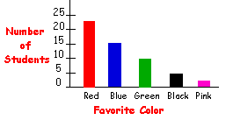
→Pictures and Graphics
A. Connect language with drawings, graphs, pictures, charts, videos, and songs

Slide 23
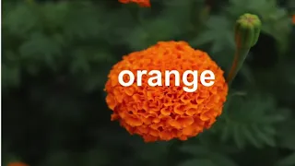
Pictures and Graphics, cont’d.
Video:
Colors, by Rita Simons Santiago
https://www.youtube.com/watch?v=fmM9V3OsOPc

Slide 24
Pictures and Graphics, cont’d. B. Use graphic organizers and mind maps C. Use color strategically
Dairy
Fruit
Food Groups
Vege-tables
Grains
Proteins

Slide 25
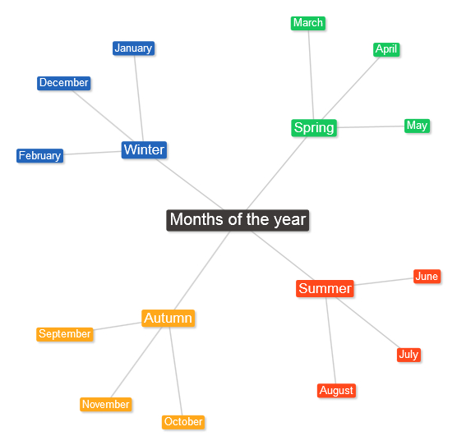
Pictures and Graphics, cont’d
http://edtechpicks.org/2017/03/text-2-mind-map/

Slide 26
→Patience
A. Speed of speech B. Wait time C. Gestures
D. Directions

Slide 27
→Physical Movement
A. Manipulatives B. Respond with physical movement C. Charades D. Art E. Recitation with rhythm F. Additional physical activities

Slide 28
Pronunciation practice example:
A
A. Rubber bands or tied elastic 1. Stretch for each syllable Words: refrigerator stomachache

Slide 29
→Discussion/Questions

Slide 30
VI. Change can occur!
Neuroplasticity
www.bodiesofevidence.com

Slide 31
Resources:
http://positivelydyslexic.co.nz/what-is-dyslexia/adult-dyslexia/adult-common-characteristics http://teacherlingo.com/resources/items/learning-the-five-food-groups.aspx (Five food groups graphic organizer) http://rainbird.ai/user-guide/2-an-introduction-to-knowledge-mapping/ (mind map)
http://atwork.settlement.org/downloads/linc/LnksLrn.pdf a manual linking second language learning, literacy, and language learning. P. Hatt, Eva Nichols
http://www.ldonline.org/article/8765/ A Guide to Learning Disabilities for the ESL Classroom Practitioner, TESL-Electronic Journal, Vol. 1 No. 1, April 1994. Christine Root
http://www.teslontario.org/uploads/research/ESLLDStrategies.pdf. Assessing Learning Disabilities in ESL. Pirie Pearl. (teacher from the TESL Ottawa Affiliate)
https://files.eric.ed.gov/fulltext/ED401687.pdf. The Adult ESL Literacy Student and Learning Disabilities. National Adult Literacy and Learning Disabilities Center. Fall, 1996.
https://listn.tutela.ca/wp-content/uploads/newsletter_fall09_learning.pdf. Bow Valley College Learning Disabilities Checklist. Bow Valley College, Calgary, AB, Canada. Fall, 2009.

Slide 32
Resources, cont’d.
https://www.ericdigests.org/2001-2/esl.html. ESL Instruction and Adults with Learning with Learning Disabilities. R. Schwartz, American University, Washington, D.C. Lynda Terrill, National Center for ESL Literacy Education. June, 2000.
https://www.atesl.ca/resources/resource-library/language-learning-for-everyone-a-resource-manual-for-teachers-with-struggling-english-language-learners/. Calgary Immigrant Women’s Association. 2013. Three main points: observe, understand, support. Also, case studies.
http://www.disabilityissues.ca/english/Link_docs/DeltaScreener-June%202011%20(NonFillable).pdf. Tool used in Canada for determining if adult students may have learning disabilities.
https://en.islcollective.com. Good general resource for worksheets, and for students with special educational needs, learning difficulties, e.g. dyslexia. Note: it is British, and also, many options may need existing graphics to be replaced with age-appropriate graphics.
https://www.slideshare.net/MELEdConference/rowekampthe-changing-iep-student-understanding-learning-issues-beyond-the-language. Slide presentation.
http://tutoringduluth.com. Good information about current research on dyslexia and related challenges.

