Slide 1
Tips, Tricks, and Activities: Teaching Math to 2nd Language Learners
Mark Sullivan
WI TESOL Conference, 2019

Slide 2
Math Warmup: Can you solve it? Tell your answer to a colleague.
16

Slide 3
Math Warmup: Can you explain it? Explain the problem to a colleague.
“If 3 apples ______________, and
__________________ equals 18,
and if 1 banana minus _________
equals _________, then 1 ______
___________________ equals16.”
16

Slide 4
Background Information
“International students, especially those bound for the United States, are heavily driven to study abroad by one factor: Improved career prospects."
-World Education News & Review (wenr.wes.org)
“International students [focus] on STEM and business majors, majors which tend to lead to high earning careers.” -Study USA (www.studyusa.com)
#1: Engineering
#2: Business & Management
#3: Math & Computer Science

Slide 5
Background Information
Teacher Education Programs: Focus on STEM Field
Hofstra University: MA TESOL with Specialization in STEM
Notre Dame of Maryland University: MA Leadership in Teaching in STEM
Programs are mostly geared towards secondary education
GRE Test Preparation
English for Specific Purposes (ESP)
A trend for specialized English programs for undergraduate and graduate students entering the STEM fields

Slide 6
Activity Ideas: Teaching Math + English
Activity 1: Re-learn Basic Math Concepts Info Gap
Activity 2: “Teachers” and “Students” Powerpoint Exercise
Activity 3: “Readers” and “Artists” Exercise

Slide 7
Activity 1: Re-learn Basic Math Concepts Whole Class Info Gap
Take a sheet (Student B); I’m Student A
Do not show me your sheet
Let’s take turns asking & answering questions to determine the formulas

Slide 8
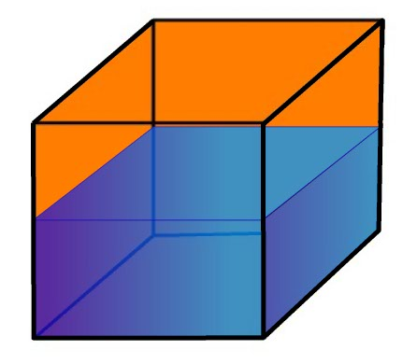
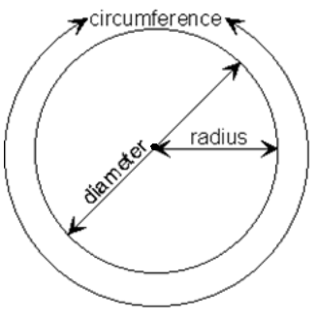
How do you find the ___________ of a ___________?
Student A: Info Gap
area
square
Area
Volume
Circumference
Perimeter

Slide 9
Activity 2: “Teachers” and “Students” Powerpoint Exercise
International Students: Difficulty understanding word problems (GRE, other standardized tests)
Practice word problems using…
Fun games
Emphasize speaking, listening, and problem-solving skills

Slide 10
Activity 2: “Teachers” and “Students” Powerpoint Exercise
Info Gap: Listen & Repeat the problem
Teacher: Face the board & read the problem aloud to your Student (read multiple times)
Student: Face away from the board, and repeat the problem (do not turn around)
Both: Solve the problem together

Slide 11
Example Math Problem: Read, Repeat & Solve

Slide 12
Example Math Problem: Answer
8 ounces

Slide 13
Activity 3: “Readers” and “Artists”
Powerpoint Exercise: Listen & Draw the problem
Readers: Face the board; read the problem aloud to your “Artist” (read multiple times)
Artists: Take a sheet of paper; Face away from the board; Draw the problem on your worksheet
Both: Solve the problem together

Slide 14
Math Problem: Read, Draw & Solve
The distance between Milwaukee and Madison is 79 miles. If a train travels at 120 mph starting from Milwaukee, and if a car travels at 65 mph from Madison, then at what point will they meet?
1 mile or mph = 1.61 km or km/h

Slide 15
Assessment Ideas
Note-taking Skills
Listen to Math videos & practice taking notes
Use 3-column Note-taking System (www.youtube.com/watch?v=mr7dz-IEJTE)
Khan Academy (www.khanacademy.org) & Ted Talks (www.ted.com/talks)
Project: Math Presentations
Students choose a Math problem (a famous one or their own)
Students prepare a presentation, and explain “how to solve it” step-by-step
-International English Center, University of Colorado Boulder

Slide 16
Assessment Ideas
Vocabulary
Teach Greek & Latin Prefixes (diameter / dia = across; meter = measure)
Students can keep a Vocabulary Log
Practice Pronunciation (e.g. tenth; sixteenth; millionth)
Possible Math Topics
Metric vs. Customary Systems, Word Problems, Algebra
Numbers, Geometry, Theory vs. Theorum, Calculus
-International English Center, University of Colorado Boulder

Slide 17
A math problem
By Janesy Liu
Vocabulary:
Square
Line
Equal
blank

Slide 18
Divide the blue part into 4 pieces and these 4 should be the same size.

Slide 20
Teaching Challenges & Tips
Limited understanding of math concepts (Students may lack confidence in you)
Frame the Course: "This is not a Math class, it’s an English class in which you talk about Math” (e.g. Communicating About Math)
Incorporate English language objectives and activities for practice
Rather than focus on solving the problems, encourage students to explain how they solved them to increase speaking and engagement

Slide 21
Mark Sullivan
Lecturer, English Language Academy
University of Wisconsin-Milwaukee
Email: sullivam@uwm.edu; sullivanm444@gmail.com

